Slide 1
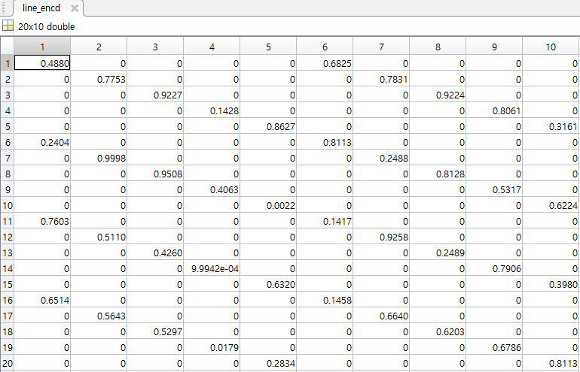
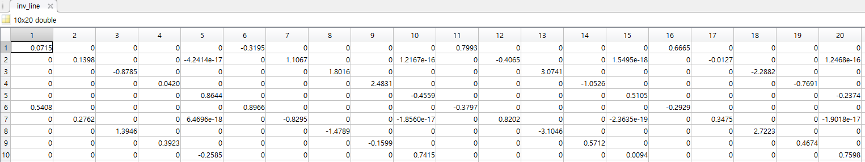
Small size[20x10]
Encd function inversion test

Slide 2
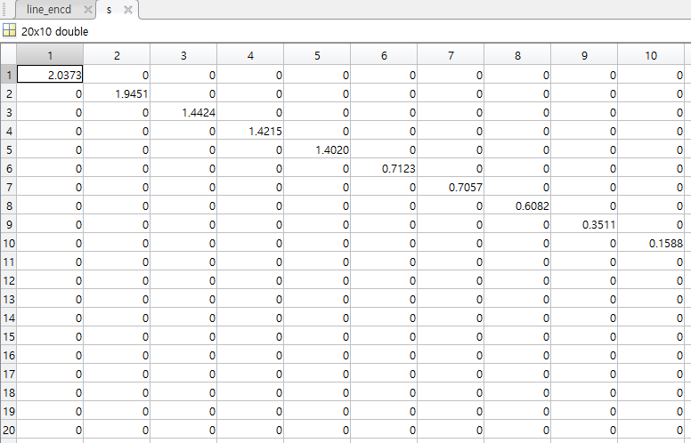
Svd(S)

Slide 3
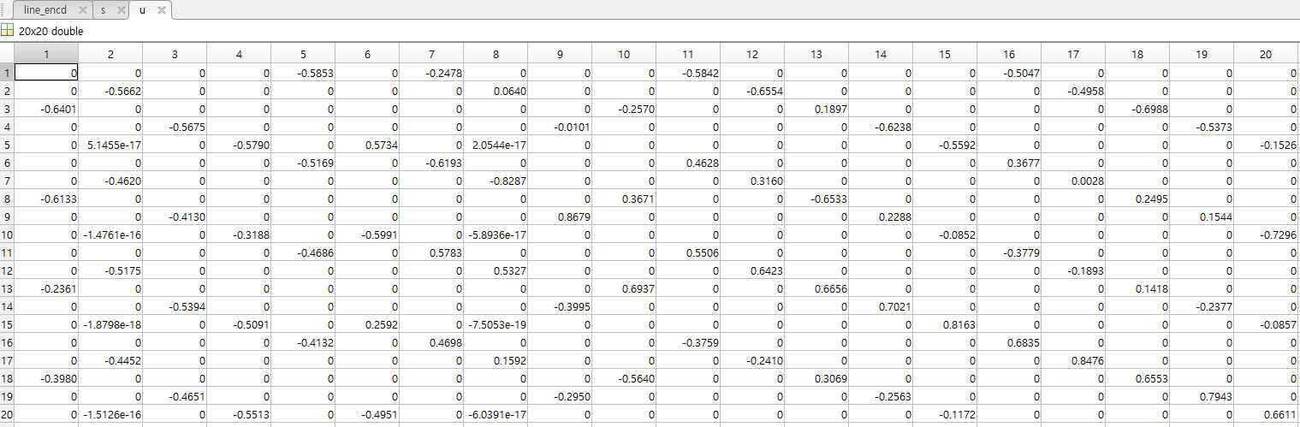
Svd(U)

Slide 4
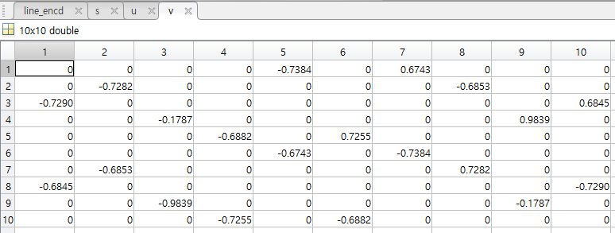
Svd(V)

Slide 5
Svd(V)

Slide 6
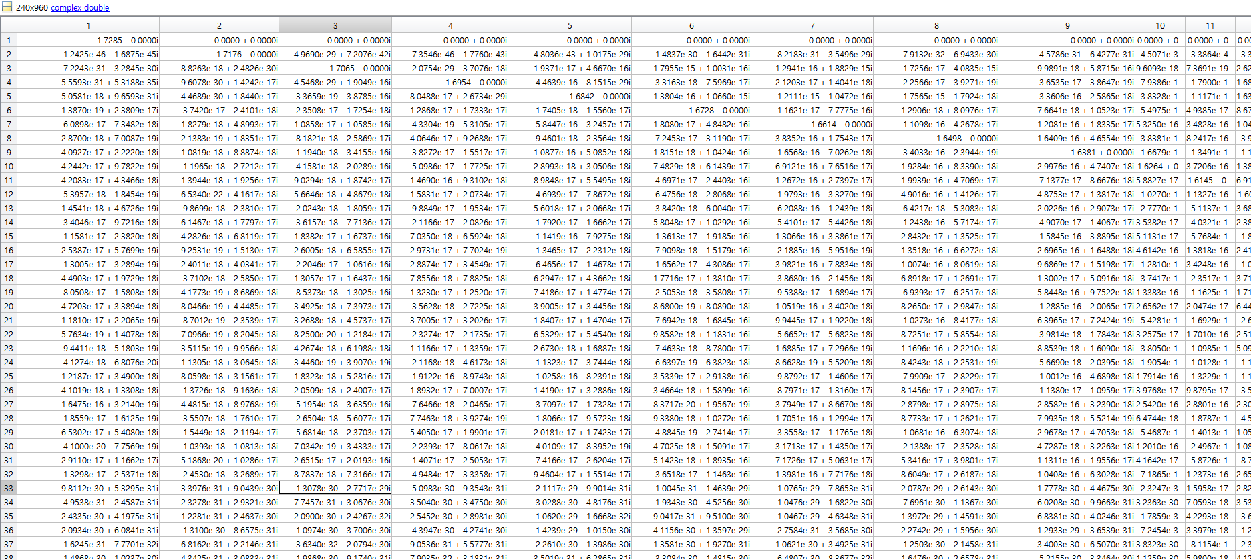
Line by line encd func pinv

